Slide 1
PREDICTING ZILLOW’S ZESTIMATE ACCURACY
GROUP #4
GOTTA CAMILLA – IERARDI ANDREA – KASENOV ULAN – LAZZARA FRANCESCO – LENI THOMAS – LEPEK ALEKSANDRA

Slide 2
PROJECT GOAL
The objective of the project is to verify the accuracy of the estimation in the report; moreover here there is a focus on the 8 information quality dimensions method
To reach the target, we analyze the information quality, IQ, through the JMP add-in

Slide 3
1- Data Evaluation and Potential Analysis 8 Information Quality Dimensions
1) DATA RESOLUTION
2) DATA STRUCTURE
40% of data points were removed due to missing information
Only 1,4 K valid points
Only one state
Multiple sources used - besides standard sq meteres also school rankings, proximity of metro
Data structure is satisfaying, it is hetergoneous
2-3
3-4

Slide 4
2- Data Evaluation and Potential Analysis 8 Information Quality Dimensions
3) DATA INTEGRATION
4) TEMPORAL RELEVANCE
Data between multiple sources used a location as primary key
There are no privacy concerns as the data is public or home owners accepted to publish it
The time span is only 3 years and due to high variation of the house prices over time the model could be easily outdated
The data needs to be refresh periodically
4
3-4

Slide 5
3- Data Evaluation and Potential Analysis 8 Information Quality Dimensions
5) CHRONOLOGY OF DATA AND GOAL
6) GENERALIZABILITY
Goal is clear
Retrospecitive
Ex-post availabilty
Only applicable to Northern Virginia, because here there are more data
4
3

Slide 6
4- Data Evaluation and Potential Analysis 8 Information Quality Dimensions
7) OPERATIONALIZATION
8) COMMUNICATION
Not clear how this evalaution could be included in decision making process
Additional presentation is included which summarise on high level the findings
3
4

Slide 7
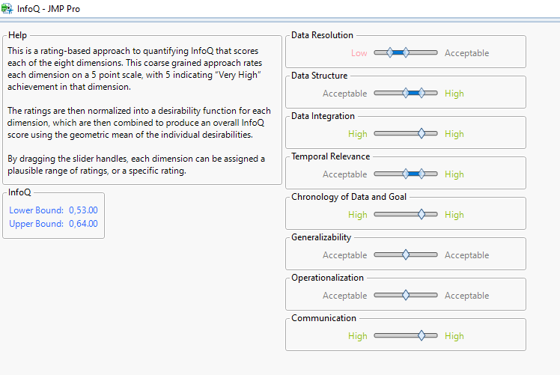
IQ= 58,5%
Table 1- InfoQ-JMP

